Slide 1
GRADE 7 ACCELERATED · UNIT 1 · LESSON 7
Writing and Solving Equations in Context
MA.7.AR.2.2
I can define, write, solve and interpret — and decide which way a decimal answer rounds.
The last equations lesson.
Two new things: fractional coefficients, and answers that have to be whole.
Grade 7 Accelerated · Unit 1 · Lesson 7 — Writing and Solving Equations in Context
1

Slide 2
Warm-Up
On your own. Four minutes.
Spaced retrieval
1.
Last lesson: a jacket priced p is 40% off. What do you pay?
2.
Last week: solve 4(x − 3) = 28.
3.
Last unit: write 0.4 as a fraction in lowest terms.
4.
Prior grade: what is 12 ÷ (1/3) ?
Grade 7 Accelerated · Unit 1 · Lesson 7 — Writing and Solving Equations in Context
2

Slide 3
Notes
I. Four rows, every time
A.
DEFINE. A sentence saying what the letter stands for.
B.
WRITE. The rate, the starting value and the total, in place.
C.
SOLVE. Inverse operations, both sides, one step at a time.
D.
INTERPRET. Answer the question in a sentence, with units.
Grade 7 Accelerated · Unit 1 · Lesson 7 — Writing and Solving Equations in Context
3

Slide 4
Notes
II. Multiplying by 1/8 is dividing by 8
A.
reciprocal — the fraction turned upside down
B.
Multiplying by 1/8 is the same as dividing by 8.
C.
So the way back is to MULTIPLY by 8 — not to divide by 8 again.
Grade 7 Accelerated · Unit 1 · Lesson 7 — Writing and Solving Equations in Context
4

Slide 5
Notes
III. For any other fraction, multiply by its reciprocal
A.
(5/3)b = 35/3 → b = (35/3)(3/5)
B.
Turn the coefficient upside down and multiply both sides by it.
C.
A decimal works too. 2/5 = 0.4, and 5.6 ÷ 0.4 = 14, the same answer.
Grade 7 Accelerated · Unit 1 · Lesson 7 — Writing and Solving Equations in Context
5

Slide 6
Notes
IV. What the number counts decides which way it rounds
A.
Solve first. Then ask what the number counts.
B.
People, buses, batches and shirts come in whole numbers. Hours, pounds and dollars do not.
C.
A maximum rounds DOWN. A minimum rounds UP. Decide from the situation, never from the decimal.
Grade 7 Accelerated · Unit 1 · Lesson 7 — Writing and Solving Equations in Context
6

Slide 7
Example 1
A fractional coefficient.
(1/4)x = 9
Before you solve: will x be bigger or smaller than 9?
Grade 7 Accelerated · Unit 1 · Lesson 7 — Writing and Solving Equations in Context
7

Slide 8
Example 1
Multiply by 4.
(1/4)x = 9
(1/4)x × 4 = 9 × 4 multiplication property of equality
x = 36
Check: (1/4)(36) = 9 ✓
Grade 7 Accelerated · Unit 1 · Lesson 7 — Writing and Solving Equations in Context
8

Slide 9
Example 1
And when the fraction is improper.
(5/2)x = 20
multiply both sides by 2/5, the reciprocal
x = 8
Check: (5/2)(8) = 20 ✓
Grade 7 Accelerated · Unit 1 · Lesson 7 — Writing and Solving Equations in Context
9

Slide 10
Example 2
A gift card.
A $60 gift card. Five equal purchases are made. $12.50 is left.
How much was each purchase?
Define your letter, then write the equation. Do not solve it.
Grade 7 Accelerated · Unit 1 · Lesson 7 — Writing and Solving Equations in Context
10

Slide 11
Example 2
Solve and interpret.
60 − 5p = 12.50
−5p = −47.50
p = 9.50
Check: 60 − 5(9.50) = 60 − 47.50 = 12.50 ✓
Each purchase was $9.50.
Grade 7 Accelerated · Unit 1 · Lesson 7 — Writing and Solving Equations in Context
11

Slide 12
Example 2
Does it need rounding?
No. Dollars come in fractions of a dollar, and $9.50 is a real price.
Grade 7 Accelerated · Unit 1 · Lesson 7 — Writing and Solving Equations in Context
12

Slide 13
Example 3
Two answers, both 6.4.
A budget allows 6.4 cases of juice.
A trip needs 6.4 buses.
How many cases can you buy?
How many buses do you book?
Same number. Do they round the same way?
Grade 7 Accelerated · Unit 1 · Lesson 7 — Writing and Solving Equations in Context
13

Slide 14
Example 3
No.
6 cases
7 buses
7 cases would cost more than the budget
6 buses would leave people behind
round DOWN
round UP
Grade 7 Accelerated · Unit 1 · Lesson 7 — Writing and Solving Equations in Context
14

Slide 15
Example 3
And sometimes neither.
An equation says a tank has been draining for −3 hours.
Grade 7 Accelerated · Unit 1 · Lesson 7 — Writing and Solving Equations in Context
15

Slide 16
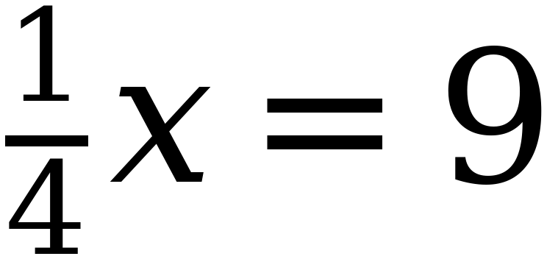
Whiteboards · Question 1 of 9
Boards up on three.
Solve it, or answer it.
Read what the number counts before you round anything.
Grade 7 Accelerated · Unit 1 · Lesson 7 — Writing and Solving Equations in Context
16

Slide 17
Whiteboards · Question 1 of 9
Answer.
multiply both sides by 4
Answer: x = 36
Grade 7 Accelerated · Unit 1 · Lesson 7 — Writing and Solving Equations in Context
17

Slide 18
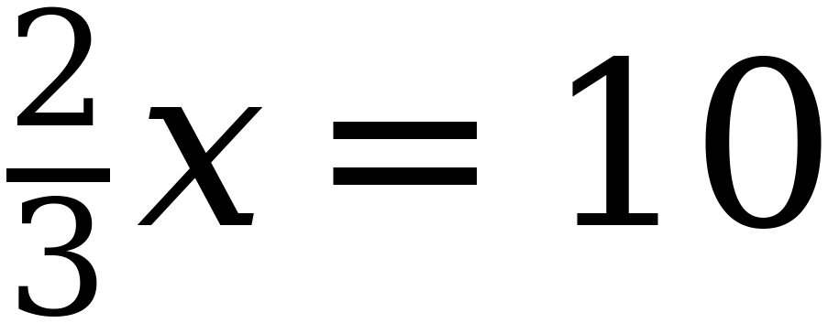
Whiteboards · Question 2 of 9
Boards up on three.
Solve it, or answer it.
Read what the number counts before you round anything.
Grade 7 Accelerated · Unit 1 · Lesson 7 — Writing and Solving Equations in Context
18

Slide 19
Whiteboards · Question 2 of 9
Answer.
multiply by the reciprocal, 3/2
Answer: x = 15
Grade 7 Accelerated · Unit 1 · Lesson 7 — Writing and Solving Equations in Context
19

Slide 20
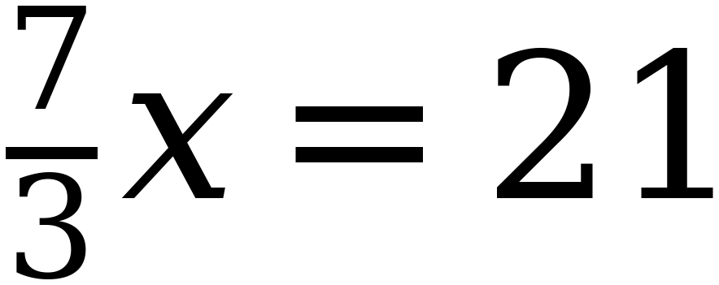
Whiteboards · Question 3 of 9
Boards up on three.
Solve it, or answer it.
Read what the number counts before you round anything.
Grade 7 Accelerated · Unit 1 · Lesson 7 — Writing and Solving Equations in Context
20

Slide 21
Whiteboards · Question 3 of 9
Answer.
multiply by the reciprocal, 3/7
Answer: x = 9
Grade 7 Accelerated · Unit 1 · Lesson 7 — Writing and Solving Equations in Context
21

Slide 22
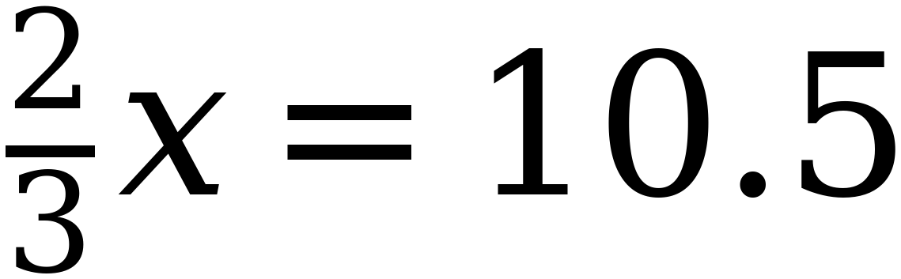
Whiteboards · Question 4 of 9
Boards up on three.
Solve it, or answer it.
Read what the number counts before you round anything.
Grade 7 Accelerated · Unit 1 · Lesson 7 — Writing and Solving Equations in Context
22

Slide 23
Whiteboards · Question 4 of 9
Answer.
multiply by 3/2: 10.5 × 3 ÷ 2
Answer: x = 15.75
Grade 7 Accelerated · Unit 1 · Lesson 7 — Writing and Solving Equations in Context
23

Slide 24
Whiteboards · Question 5 of 9
Boards up on three.
A budget allows 15.75 students on a trip. How many go?
Solve it, or answer it.
Read what the number counts before you round anything.
Grade 7 Accelerated · Unit 1 · Lesson 7 — Writing and Solving Equations in Context
24

Slide 25
Whiteboards · Question 5 of 9
Answer.
A budget allows 15.75 students on a trip. How many go?
16 would go over budget
Answer: 15 students
Grade 7 Accelerated · Unit 1 · Lesson 7 — Writing and Solving Equations in Context
25

Slide 26
Whiteboards · Question 6 of 9
Boards up on three.
A trip needs 15.75 vans. How many do you book?
Solve it, or answer it.
Read what the number counts before you round anything.
Grade 7 Accelerated · Unit 1 · Lesson 7 — Writing and Solving Equations in Context
26

Slide 27
Whiteboards · Question 6 of 9
Answer.
A trip needs 15.75 vans. How many do you book?
15 would leave people behind
Answer: 16 vans
Grade 7 Accelerated · Unit 1 · Lesson 7 — Writing and Solving Equations in Context
27

Slide 28
Whiteboards · Question 7 of 9
Boards up on three.
Peyton has a $40 gift card. She buys the same thing four times and has $7.08 left. What did each one cost?
Write the equation and solve it.
Read what the number counts before you round anything.
Grade 7 Accelerated · Unit 1 · Lesson 7 — Writing and Solving Equations in Context
28

Slide 29
Whiteboards · Question 7 of 9
Answer.
Peyton has a $40 gift card. She buys the same thing four times and has $7.08 left. What did each one cost?
40 − 4c = 7.08, so 4c = 32.92
Answer: $8.23 each
Grade 7 Accelerated · Unit 1 · Lesson 7 — Writing and Solving Equations in Context
29

Slide 30
Whiteboards · Question 8 of 9
Boards up on three.
Shirley gives each of her eight grandchildren a $15 gift card AND the same amount of cash. She spends $280 in total. How much cash each?
Write the equation and solve it.
Read what the number counts before you round anything.
Grade 7 Accelerated · Unit 1 · Lesson 7 — Writing and Solving Equations in Context
30

Slide 31
Whiteboards · Question 8 of 9
Answer.
Shirley gives each of her eight grandchildren a $15 gift card AND the same amount of cash. She spends $280 in total. How much cash each?
8(15 + c) = 280, so 15 + c = 35
Answer: $20 each
Grade 7 Accelerated · Unit 1 · Lesson 7 — Writing and Solving Equations in Context
31

Slide 32
Whiteboards · Question 9 of 9
Take your time. Boards up when you have written it.
Songs cost $1.75 each. Georgina has a $50 gift card. How many songs can she buy, and how much is left?
Write your answer in sentences.
This one is written work. Say why you rounded the way you did.
Grade 7 Accelerated · Unit 1 · Lesson 7 — Writing and Solving Equations in Context
32

Slide 33
Whiteboards · Question 9 of 9
Answer.
Songs cost $1.75 each. Georgina has a $50 gift card. How many songs can she buy, and how much is left?
50 ÷ 1.75 = 28.57…; 29 songs cost $50.75
Answer: 28 songs, $1.00 left
Grade 7 Accelerated · Unit 1 · Lesson 7 — Writing and Solving Equations in Context
33

Slide 34
IXL
Last five minutes.
1.
Open IXL and start today's skills.
2.
Work on paper where the question needs work. The answer box does not show it.
3.
Whatever you do not finish is tonight's practice.
4.
The skills for today are posted in Google Classroom.
Grade 7 Accelerated · Unit 1 · Lesson 7 — Writing and Solving Equations in Context
34

